Slide 1
Practical – 1 JIRA Fundamentals
Aruna Kumbhar

Slide 2
Scenario
We are employees of TechSoft Pvt. Ltd.
Our client wants us to build a Food Delivery Application like Swiggy.
We will manage this project using Jira.

Slide 3
What is JIRA?
Jira
Definition: Jira is an Agile project management and issue-tracking tool developed by Atlassian. It is used for sprint planning, task management, bug tracking, and project monitoring.
Example: Amazon uses Jira to manage software development tasks.

Slide 4
Implementation
Step 1: Create a Jira Site
Open: https://www.atlassian.com/software/jira/free
Register / Login
Once logged in, it will ask you to create “Site” first - Think of this as your company's office building. Everything happens inside this Site
A Site is the main Jira workspace where all projects, users, dashboards, and settings are stored

Slide 5
Implementation
Step 2: Create a Project
Click
Projects
↓
Create Project
↓
Scrum
↓
Food Delivery App
Project = One software product
Examples:
WhatsApp
Netflix
College ERP
Can one company have multiple projects?

Slide 6
Implementation
Step 3: The Left Menu
Roadmap
Backlog
Board
Timeline
Releases
Issues
Reports

Slide 7
Need of Agile S/W Development
What if Amazon released only login and shopping cart in one month?
Customers start using it
Feedback arrives
Developers improve
This is Agile
Definition
According to Roger Pressman
Agile is a software development philosophy that emphasizes incremental delivery, customer collaboration, adaptability, and rapid response to change.

Slide 8
Why Traditional Methods Failed
Problems:
❌ Requirements change
❌ Market changes
❌ Technology changes
❌ Competitors launch earlier
❌ Customer dissatisfied
Requirement
↓
Design
↓
Coding
↓
Testing
↓
Customer
Agile solved:
✔ Frequent delivery
✔ Customer involvement
✔ Early testing
✔ Faster feedback
✔ Lower risk
Customer waits 1–2 years

Slide 9
History of Agile
Before Agile, Software followed
Waterfall
Spiral
V Model
RAD
Prototype
Interesting Fact
In the 1990s, Nearly 70% software projects either failed or exceeded budget
But, Software projects kept failing
Many developers became frustrated

Slide 10

History of Agile
In February 2001
17 software experts met At Snowbird Ski Resort, Utah, USA
What were software engineers doing in a ski resort?
They changed software history

Slide 12
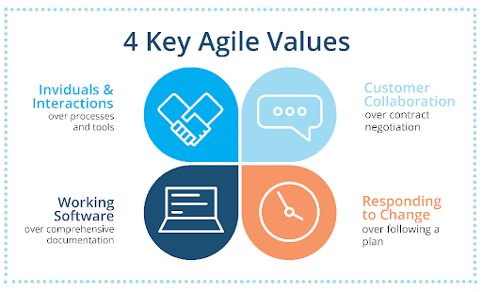
Agile Manifesto – 4 VALUES
Suppose, Wi-Fi stops working.
Instead Following 10 documents
takes hours, Two developers discuss together
Problem solved
People matter more
Netflix continuously asks
"What features do users like?"
Instead of saying
"This wasn't in contract."
COVID arrived.
Food delivery apps started
Medicine delivery.
That's Agile thinking
Which impresses customer?
100-page document
OR
Working mobile app?
Obviously
Working software

Slide 13
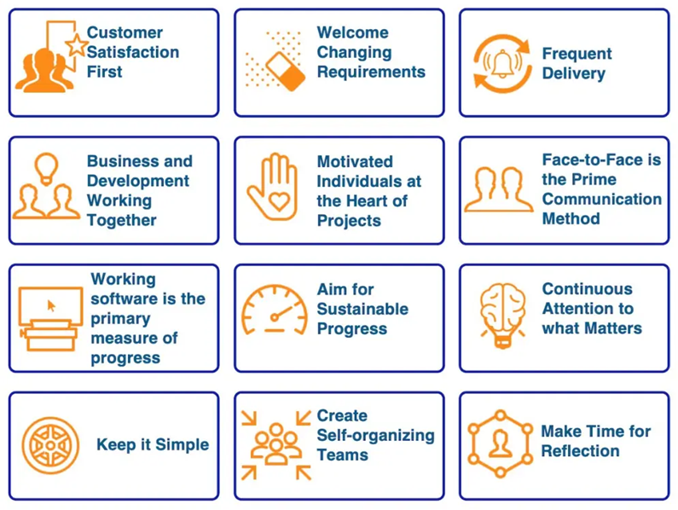
Agile Manifesto – 12 Principles

Slide 14
Traditional vs Agile
Traditional | Agile
Big planning | Small planning
Late delivery | Early delivery
Customer at beginning | Customer throughout
Testing at end | Testing continuously
Changes difficult | Changes welcome
High risk | Lower risk
Documentation heavy | Working software focus
Traditional Write entire book Then publish
Publish one chapter every week. Readers give feedback Improve next chapter

Slide 15
Which is better – Traditional or Agile for
Instagram
Bridges

Slide 16
Stakeholders and Challenges
Stakeholders
Customer
Product Owner
Developers
Testers
Scrum Master
Managers
End Users
Business Team
Operations Team
Example
Food Delivery App
Customer
Restaurant
Delivery Partner
Developer
Tester
Manager
Everyone is stakeholder

Slide 17
Stakeholders and Challenges
Challenges
Changing requirements
Communication
Distributed teams
Customer availability
Team resistance
Poor documentation
Scope creep
Can Agile fail?

Slide 18
Classification of Agile Methods
Agile is not one methodology. It is an umbrella
Agile
├── Scrum
├── XP
├── Kanban
├── Lean
├── Crystal
├── Feature Driven Development
├── DSDM
└── Adaptive Software Development
Scrum → Sprint based
XP → Coding practices
Kanban → Visual board
Lean → Remove waste
Crystal → Team centric
FDD → Feature based
DSDM → Rapid delivery
ASD → Adapt continuously

Slide 19
You have visited a restaurant. And ordered food
Now explain in waterfall model, how the food will arrive
Now explain in Agile model, how the food will arrive
Wait 3 hours.
Chef brings
Soup
Starter
Main Course
Dessert
all together
Soup is cold.
You don't like spicy food.
Too late
Soup first.
You give feedback.
Starter next.
Feedback.
Main course.
Feedback.
Dessert.
Everyone gets exactly what they want

Slide 20
Real World Agile Examples
Company | Agile Example
Netflix | Weekly deployments
Amazon | Continuous feature releases
Google Maps | Frequent updates
WhatsApp | Incremental features
Spotify | Squad-based Agile
Instagram | Regular UI improvements

Slide 21
Summary
Software development evolved from rigid, long-cycle models to Agile because business needs and technology change rapidly
Agile is a mindset focused on delivering value, rather than just following a process
The Agile Manifesto is built on 4 values and 12 principles that emphasize collaboration, adaptability, and working software
Agile involves multiple stakeholders working together continuously, with customer feedback guiding development
Scrum, Kanban, XP, Lean, Crystal, FDD, DSDM, and ASD are all different Agile methods, each suited to different project needs

